Slide 1
Voice Vault
APPLICATION DOMAIN:CLOUD COMPUTING,CRYPTOGRAPHY
BATCH-No :B -05
Guide: Mrs Ch.Swapna Priya,M.Tech,(Ph.D)
REGISTER NUMBERS | NAME OF STUDENTS | NO OF MEETINGS WITH GUIDE
18L31A05F6 | K. Chandra Priya
18L31A05B7 | B. Nitish Kumar Rao
18L31A05F9 | S. Sai Mithilesh
18L31A05G0 | R. Ajay

Slide 2
Abstract
Voice Vault is a desktop-based application designed and developed using the python programming language. The tool aims to make cloud storage with proper encryption. The encryption algorithm is self-developed, accurate, and secured. Along with Encrypted cloud storage, we are also providing proper user authentication. User authentication is done using Voice Recognition System. A user’s voice is verified locally against itself, a token is sent to the service provider, and access is granted. We developed a voice recognition system using python & machine learning. It won’t give access to the user until the voice doesn’t match. We used ‘python speech features and pyaudio modules of python for taking voice samples and for preprocessing it, we used the GMM model (Gaussian Mixture Model).

Slide 3
Motivation/Origin
Effective and Reliable data security is very important in present days. Everyone aims to keep their personal data like files and images to be secure.For achieving this many software/tools are developed that enable you to prevent other people from viewing, editing, and deleting files and directories,but all these softwares provide user authentication using password and charge you money for accessing them.By taking this as a reference we have developed a software named Voicevault which provides proper authentication using Voice recognition system and enables user to keep their personal data secure.This tool can be accessed in the real world from any device and the password that is spoken cant be hacked as there are no softwares till date that can hack frequencies.
DEPARTMENT OF CSE

Slide 4
Existing System
Often many software/tools enable you to prevent other people from viewing, editing, and deleting files and directories. These programs use encryption techniques for security. These tools are designed for protecting files/folders on your local computer. Many such programs can be used to lock directories on a flash drive, external USB drive, internal hard drive, and more. These tools have ads and charge you money for the protection of files.

Slide 5
Proposed System
The proposed tool can be accessed in the real world from any device. There are hacking softwares that can pick up everything entered through the keyboard and store it into a buffer. Hence a password entered through the keyboard can be easily hacked. However, if a password is spoken and the frequencies are considered, there is no software to date that can hack frequencies. The authors present an innovative technique for desktop file hiding. The software-based on this work is capable of locking files such that only the user who has locked them with his spoken password can access them.

Slide 6
Modules
Tkinter : Tkinter is the standard GUI library for Python. Python when combined with Tkinter provides a fast and easy way to create GUI applications .
Syntax : from tkinter import *
PIL : Python Imaging Library is a free and open-source additional library for the Python programming language that adds support for opening, manipulating, and saving many different image file formats.
Syntax : from PIL import ImageTk, Image
Wave : The wave module in Python's standard library is an easy interface to the audio WAV format. The functions in this module can write audio data in raw format to a file like object and read the attributes of a WAV file.
Syntax : import wave
Pickle : Python pickle module is used for serializing and de-serializing a Python object structure.
Syntax : import pickle

Slide 7
Modules
Pyaudio : With PyAudio, you can easily use Python to play and record audio on a variety of platforms, such as Linux, Microsoft Windows, and Apple Mac OS X.
Syntax : importpyaudio
Numpy : NumPy is a Python library used for working with arrays. It also has functions for working in domain of linear algebra, fourier transform, and matrices.
Syntax : import numpy as np
Sklearn : Scikit-learn is a free machine learning library for Python. It features various algorithms like support vector machine, random forests, and k-neighbours, and it also supports Python numerical and scientific libraries like NumPy and SciPy.
Syntax : from sklearn import preprocessing
Scipy : SciPy is a scientific computation library that uses NumPy underneath. SciPy stands for Scientific Python. It provides more utility functions for optimization, stats and signal processing. Like NumPy, SciPy is open source so we can use it freely.
Syntax : from scipy.io.wavfile import read

Slide 8
Modules
Threading : Threading module in python provides us classes and methods to create and start threads in python for implementing multithreading. Syntax : import threading as T
Mysql connector : It enables Python programs to access MySQL databases, using an API .
Syntax : import mysql.connector as msc
Essential_generators : The purpose of this module is to quickly generate data for use cases like load testing and performance evaluations .
Syntax : from essential_generators import DocumentGenerator
Python_speech_features : This library provides common speech features for ASR including MFCCs and filterbank energies.
Syntax : importpython_speech_features as mfcc
Gaussian Mixture: GMM is a machine learning model which is used to train data.
Syntax : from sklearn.mixture import GaussianMixture

Slide 9
SYSTEM Requirements
Windows / Linux / Mac OS
The proposed application is system independent.
Microsoft Visual Studio 2010 Or Higher
This is an IDE that is used to develop this windows based desktop application.
SQL
To query the data My SQL is used which is an open source relational database management system.
Tkinter
Used to create Graphical User Interface for the application

Slide 10
Methodology/Algorithm(s)
Gaussian Mixture Model (GMM) is used to train the audio files to get the speaken word recognized and AES algorithm is used for providing security.
AES plain text must be 128 bits long.
The key size can be 128, 192, or 56 bits. 128-bit AES encryption pseudocode:
A. Performs a one-time initialization process:
a. Expand the key of 16-byte
b. Performs initialization of a 16-byte plain text block named State.
B. In each round, continue with the next operation.
a. Apply the S-Box to state
b. Rotate plaintext line K by K bytes
c. Performing a column merge operation
d. XOR state with the button.

Slide 11
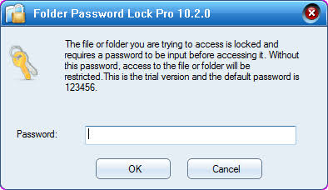
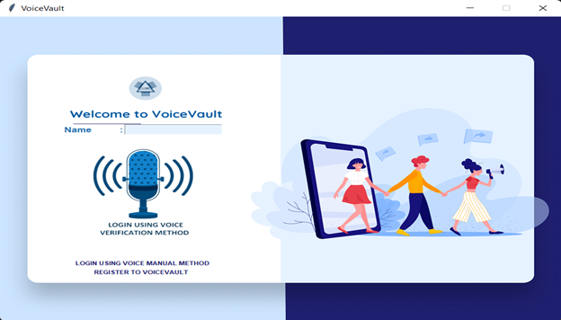
Results
Existing File Locker
Voice Vault

Slide 12
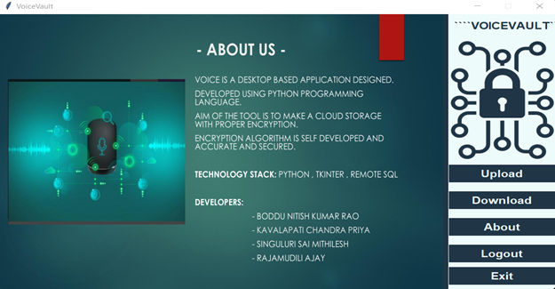
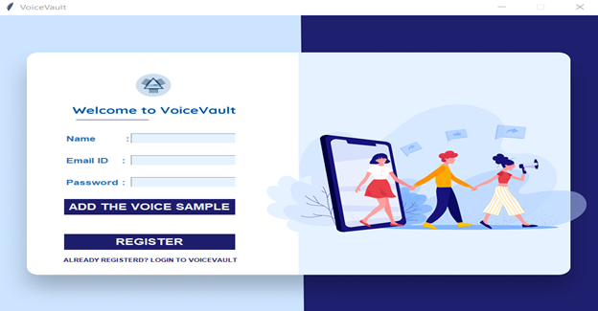
Output Screen(s)
Registration
Login

Slide 13
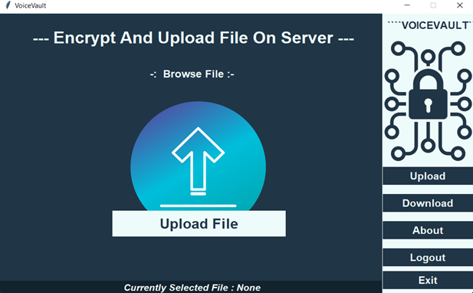
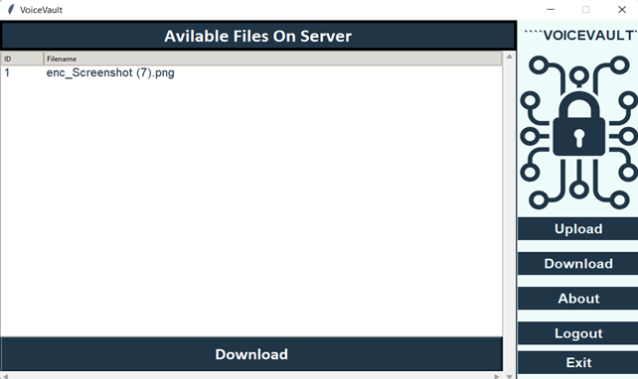
Output Screen(s)
Uploading into cloud
Downloading from server

Slide 14
Time Line
Stages | Time required
1. Problem identification and definition | 1 Week
2. Collection of the related articles and requirements | 1 Week
3. Contact guide and industrial people for designing | 2 Weeks
4. Building a model for proposed work | 2 Weeks
5. Implementation, Testing, Results and Analysis | 3 Weeks
6. Thesis, preparation and submission. | 1 Week
DEPARTMENT OF CSE

Slide 15
References
[1]. Do, Minh N. "An Automatic Speaker Recognition System", Digital Signal Processing Mini -Project. June 2005.
[2]. Md. Rashidul Hasan, Mustafa Jamil, Md. Golam Rabbani and Md. Saifur Rahman, "Speaker identification using Mel frequency Cepstral coefficients", 3rd International Conference on Electrical & Computer Engineering ICECE 2004, December 2004.
[3]. Hagai Aronowitz, David Burshtein, " Efficient Speaker Identification and Retrieval ". http://en.wikipedia.org/wiki/MATLAB. http://www.mathworks.com/help/pdf_doc/matlab/ getstart.pdf .
[4]. Archana Shende, Subhash Mishra and Shiv Kumar, " Comparison of different parameters used in GMM based automatic voice recognition ", International Journal of Soft Computing and Engineering (IJSCE), July 2011

